Slide 1


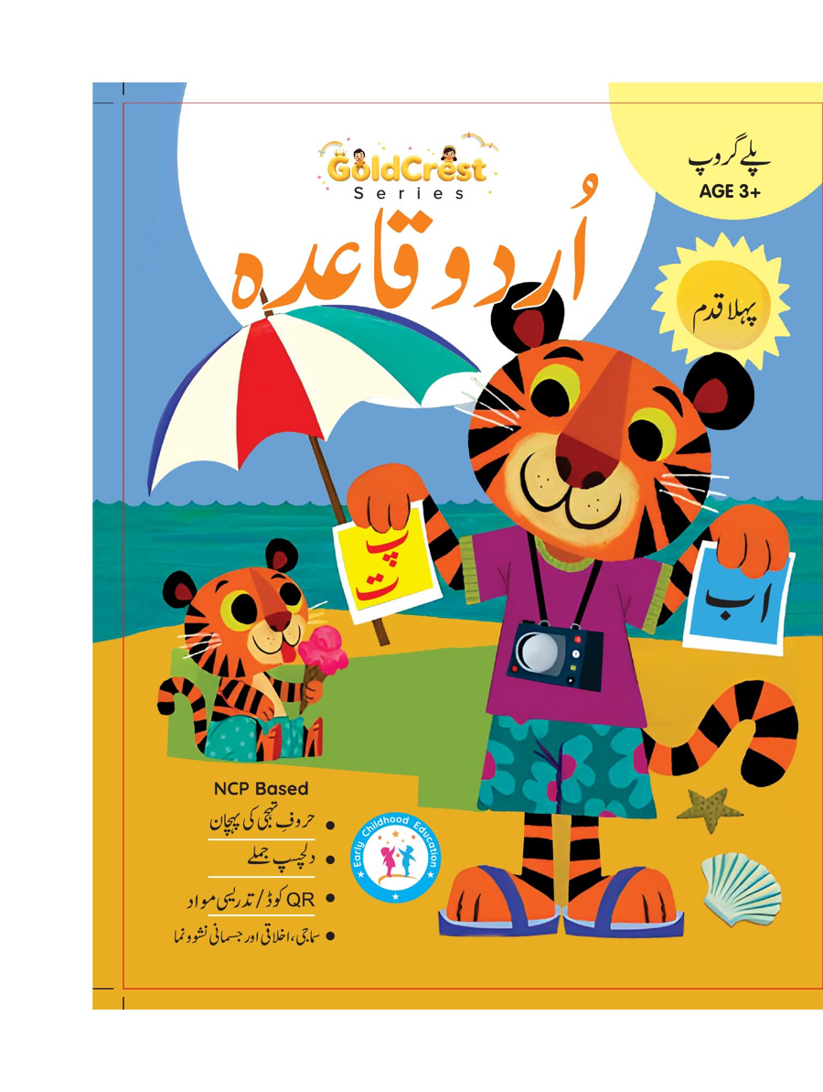
GoldCrest Urdu Qaida
Playgroup • Age 3+
An activity-based early-years book from the GoldCrest Series.
A Project of Azhar Publishers & Book Factory

Slide 2
i
What's Inside
GoldCrest Urdu Qaida Playgroup • Age 3+
1
Full Urdu alphabet with pictures
2
Letter recognition
3
Tracing and sound practice
4
Lively poems for young learners
5
Development pages
6
Fun revision activities

Slide 3
★
Purpose & Classroom Support
Familiarises our youngest learners with Urdu letters and sounds through big pictures and play.
“
Every book comes with
1
2
3
Teacher's Lesson Plan
Practice Papers
Digital Interactive Version
A 40-week lesson plan that guides teachers, day by day.
Monthly tests and term exam papers for children to attempt.
An interactive flipbook and digital exercises for engaging, screen-based practice.
A Project of Azhar Publishers & Book Factory

